Slide 1
DSA-7040 Big Data Visualization Final Project
Gun deaths in the US since
I bought my first gun

Slide 2
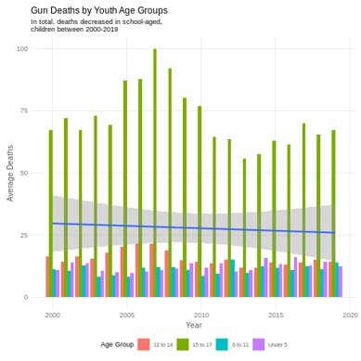
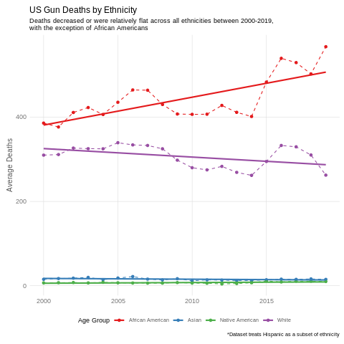
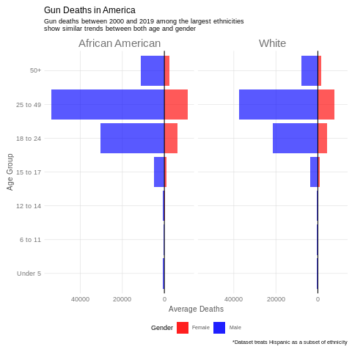
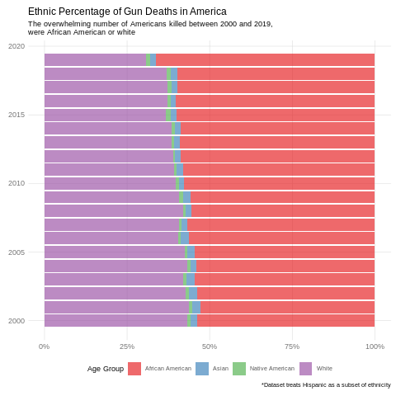
Despite the rise in school shootings in the US in the two decades since I bought my first gun, gun deaths among the youth in America has trended downward
By far, gun deaths in the US occur in specific demographics – African Americans and white men between the ages of 18 and 49

Slide 3
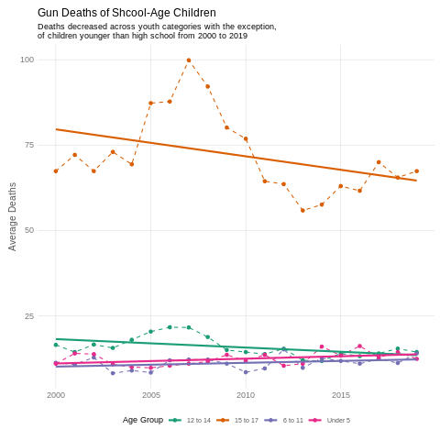
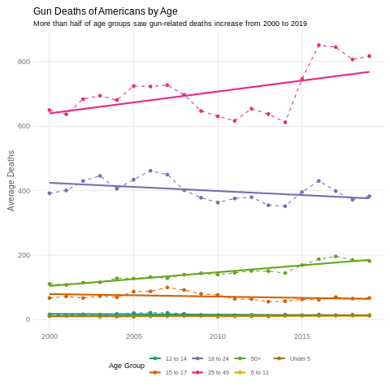
Despite the overall trend, more of the youngest Americans are dying every year
Elementary shool-aged children and younger are the only youth age groups with increased gun deaths
Despite the fact most school-aged children saw a decline in gun deaths, as a whole more Americans died by gun violence in 2019 than in 2000
Despite what our preconceived notions may be and what feels right anecdotally, the numbers show childhood deaths due to gun violence have decreased since 2000. The issue of guns in American and gun violence is complicated and intertwined with many other factors in society. Research and data are the only way we can conceivably get an understanding of the issue.

